Slide 1

Real Estate Management System (sabkoghar.com)
Presented By :-
Anjan Pudasaini
Exam Roll No. = 7210/16

Slide 2
sabkoghar.com
It lists all the property of an individual seller so that the they could easily reach potential buyer directly.
Easu user interface

Slide 3
Introduction
Real Estate Online system: This is an online project developed using Bootstrap, PHP and MySQL.
There are 2 different types of users i.e. Admin and Seller.
Only admin can access admin panel where admin manages listed properties.
Only seller can list their properties along with all needed details.
Seller profile is maintained.
Everyone can access home page where all properties are listed.
Properties in desired location can be searched.

Slide 4
Objective
Make the easy direct contact between individual buyer and seller.
Make the centralized platform for posting and selling property.
Helps to save individuals time as well as cost spent in search of property.
Make the user interface as simple as possible.

Slide 5
Problem Identified
Users still rely on offline agents.
There are very few systems that provide efficient service in Nepal.
Most of the existing system have design issues.
Various existing systems seem to have bad user interface and are not responsive.

Slide 6
Modules
Admin
Update Properties
Remove Properties
Manage Sellers
Add Properties
User
View Property List
Search For Property
See Property Details
Contact Seller
Register and post properties

Slide 7
Software Requirement
Windows Xp, Windows 7(ultimate, enterprise) and above
MySql
Sublime Text/Brackets
Xampp Server
SQLyog
Php

Slide 8
Hardware Components
Processor –Pentium and above
Hard Disk – 5 GB
RAM – 128MB Or more

Slide 9
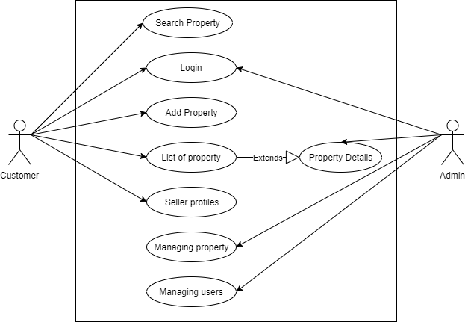
Use Case Diagram

Slide 10
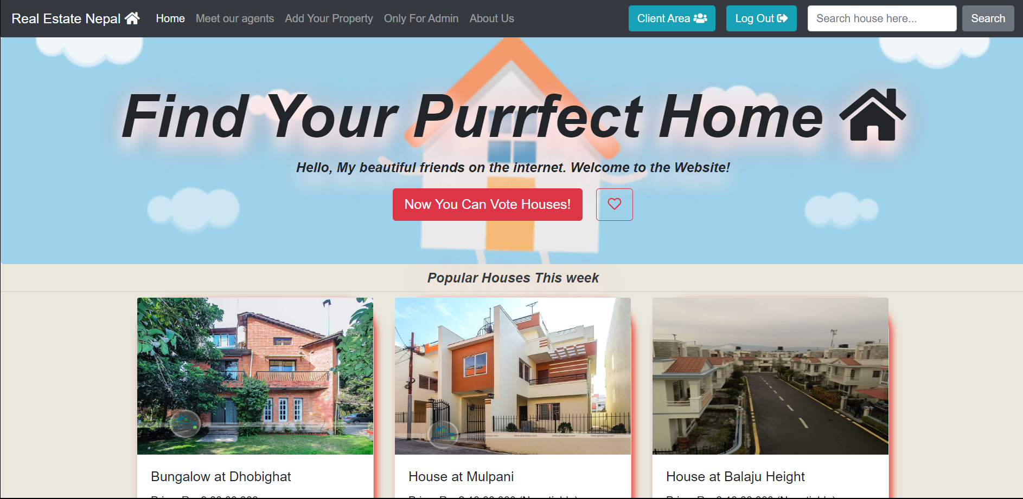
Frontend Look Of Website

Slide 11
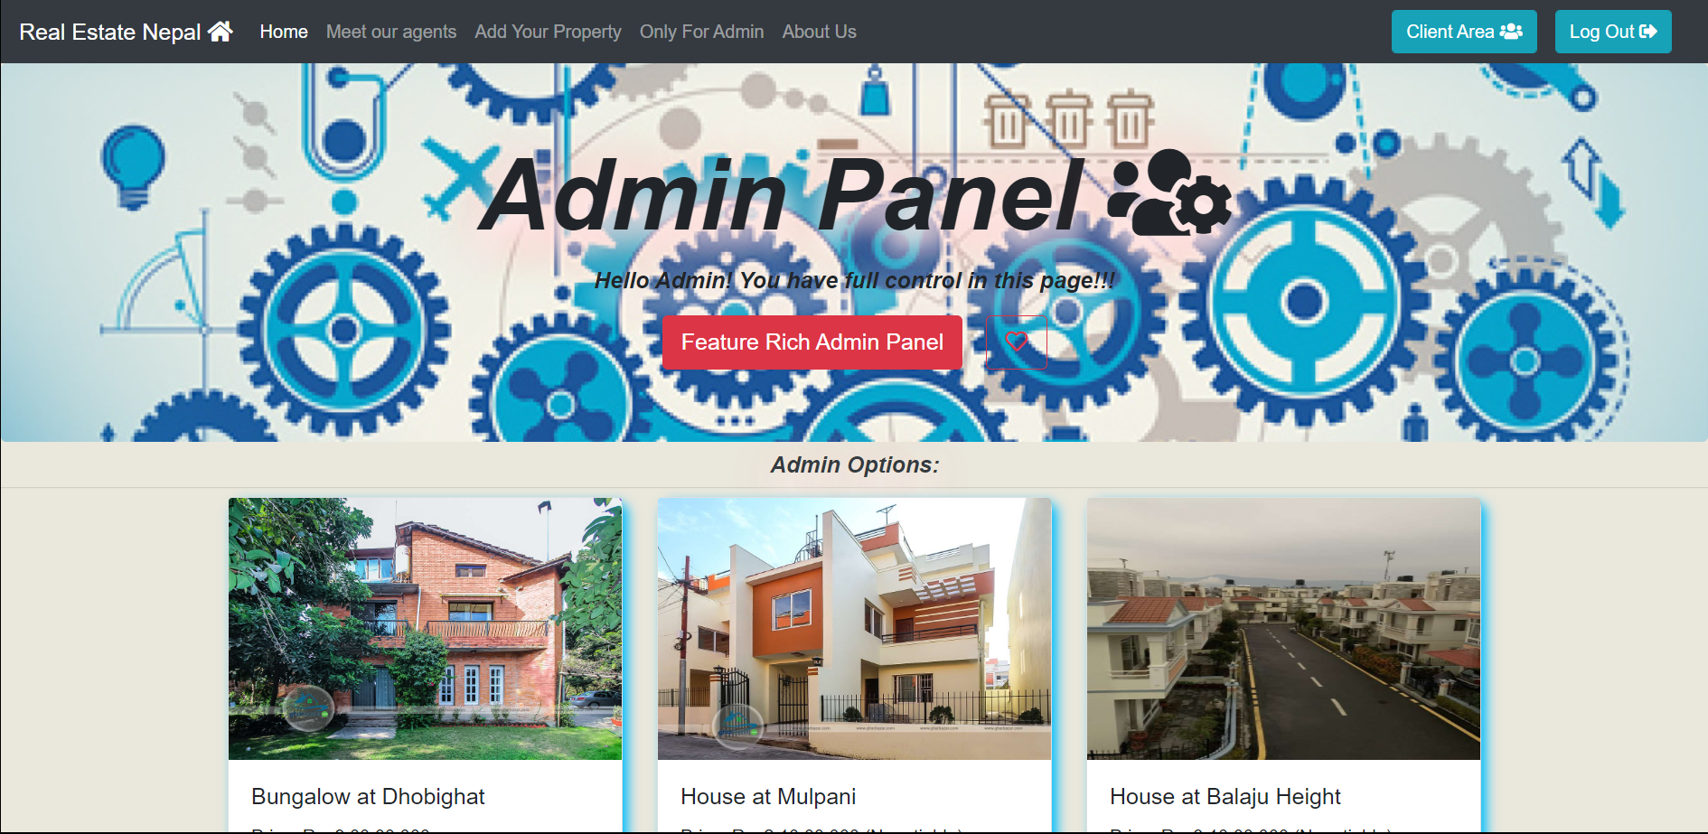
Admin Panel

Slide 12
Application
Our website would be helpful for those who want to list their property for sale.
It validates seller before listing property for security.
It provides a really good and easy user interface as compared to other existing systems in market.
The main advantage of this application is that it is responsive and everyone can easily understand about the featues.

Slide 13
Conclusion
After a continuous work and effort of our team we successfully developed web application ‘Real Estate Online System’ working very efficiently.
The web application will help lot of individual potential buyer to communicate with the right seller and find the property they want.

Slide 14
Thank you for your time…

